Slide 1
To-Do List
Yin Wah Yip

Slide 2
Task: Create a To-Do List
Understanding project scope, Key things
“stores tasks in a file and supports adding, removing, and listing tasks”
“The application can be command-line-based; a UI is not necessary”
Research: What does a to-do list actually have?
Key / Basic Features?
Unique ID, Description, Categories

Slide 3
Process to Run, Test & Verify (1)
Currently using a VSCode extension that compiles and runs
OR
Compile: javac -d bin src/com/todo/*.java
Run: java -cp bin com.todo.Main
Coded / Running on Java SE-17

Slide 4
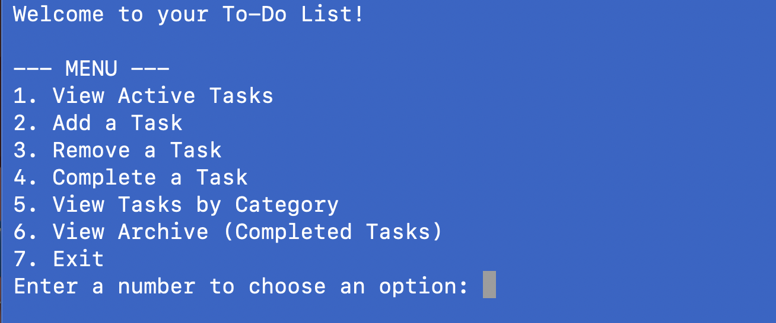
Process to Run, Test & Verify (2)
Command Line based project
Eg. Entering “2” - Add a Task:
User provides String input - Title / Description of task, with following prompt on a category

Slide 5
Key Files and Folders
Main.java
Entrance into the code
Manager.java
Main meat that manages how things are moved around
Mainly manages File I/O
Task.java
“Blueprint” for data, restrictions and abstraction
Output:
todo_list.txt && completed_list.txt

Slide 6
Challenges, Future (?)
What I wanted to add but couldn’t due to:
Limited Time
Prototyping
Complexity / Scope
Some features too big / didn’t know how to implement
Formatting

